Slide 1


Luxurious Creation:
Visualize Around Yourself With AR
By
PULKIT KUMAR VERMA, ARADHYA PANDEY AND ANKITA YADAV
Under the Supervision of
PROF. JYOTI KHANDELWAL
Dept. of Computer Science & Engineering
University of Engineering & Management, Jaipur

Slide 2

Outlines
Introduction
Literature Review
Objectives
Proposed Model
Experimental Setup
Result
Result Analysis
Conclusion & Future Scope
Reference
Acknowledgement

Slide 3
Introduction
The "Luxurious Creation: Visualize Around Yourself With AR" website aims to revolutionize furniture shopping by incorporating augmented reality (AR) technology.
Users will be able to visualize how various furniture pieces would look and fit within their own living spaces before making a purchase decision and getting orders delivered with desired colours and customization in designs.
This research aims to gather information regarding the effectiveness experienced by customer and sellers and their benefits.
Notes:
1. rPoblem: in-person purchase, customization problem, online order return, young members
2. Solution : website(3d model, Visualise, contact form ,customization, AR, online shopping)

Slide 4
Literature Review
[1] In (Genevese et al., 2012), This paper present the framework for developing a Mobile Augmented Reality (MAR) and is about the designing of mobile augmented reality (MAR) applications.
[2] In (Paula et al., 2020), The writer highlights the way of using and taking advantage of 3D models in real life. The 3D models provide almost real-life experience.
[3] In (Peroni et al., 2017), This paper present a tree logic for algorithmic reasoning about CSS selectors, i.e., by developing algorithms for deciding the satisfiability of formulas in the logic.

Slide 5
Literature Review
[4] In (Quintero et al., 2019), This paper appears to provide an overview of the research methodology, including the search process and analysis of the selected studies.
[5] In (Saidin et al., 2015), The paper introduce the research articles in simplified HTML, which is a web-first format for writing HTML-based scholarly papers.
[6] In (Silva et al., 2003), The paper describes the main concepts of Augmented Reality, its current applications, and important AR devices. The overview of characteristics of Augmented Reality systems and discussions on future directions.

Slide 6
Objectives
User-friendly interface: This website encourages the user to buy furniture online by providing a user-friendly environment and a real-time view of their space.
Customization: To Provide the options to buy items of furniture of their desired colour choice.
Personalised App Service: To provide users with a login and registration facility to get the personal cart and a wishlist option for easy product interaction.

Slide 7
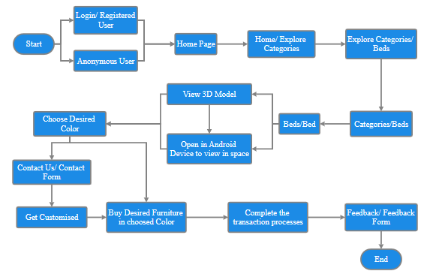
Proposed Model
Notes:
Browse

Slide 8
Experimental Set-up
Software | Hardware
Visual Studio Code Editor | Laptop
HTML/CSS | RAM/ Memory
PHP | Internet
Database | Android Device
Git & Github
Model Viewer Editor
Sketchfab

Slide 9
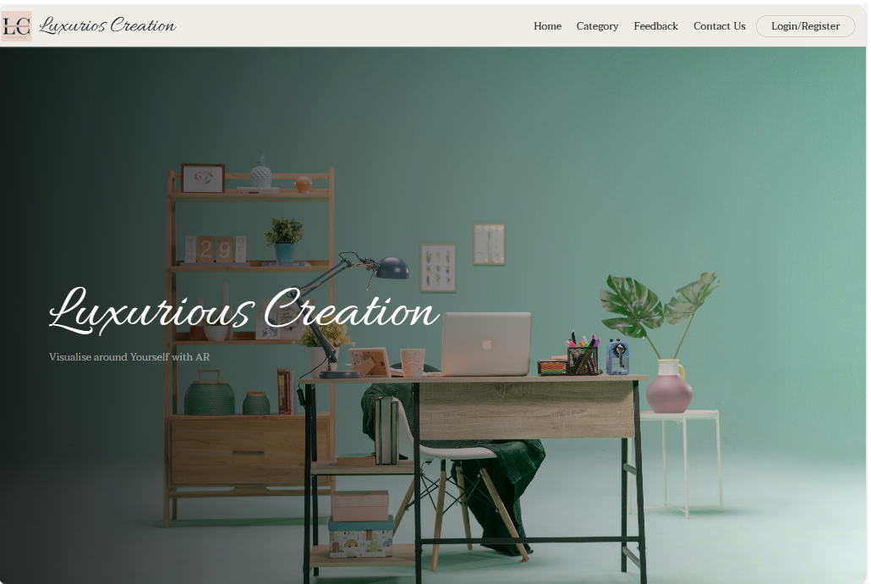
Result
Figure 1: Home Page

Slide 10
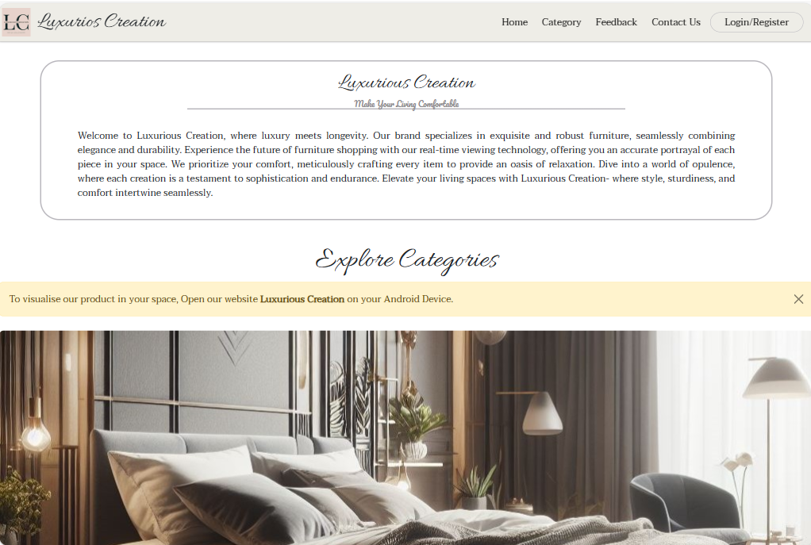
Result
Figure 2: Home Page/Introduction

Slide 11
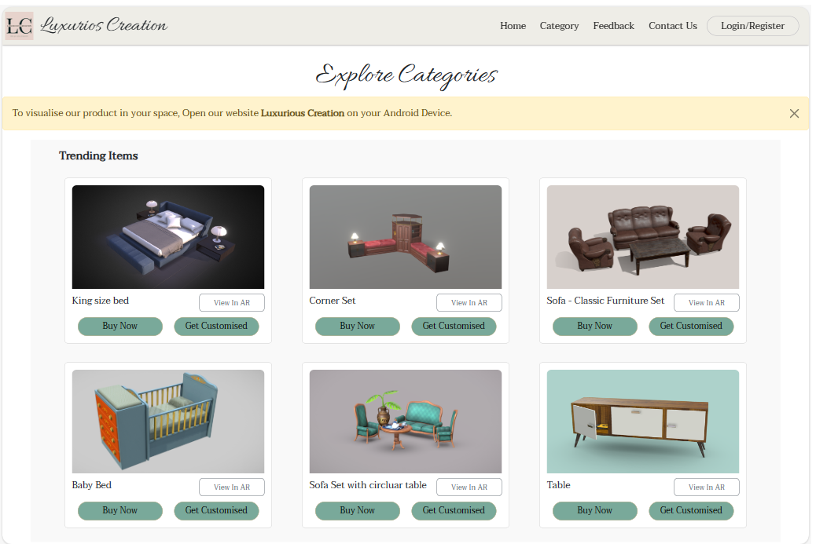
Result
Figure 3: Categories/Trending Section

Slide 12
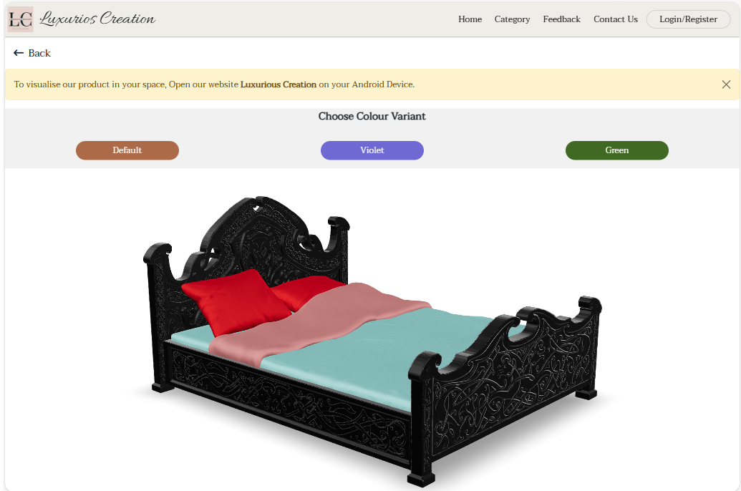
Result
Figure 4: Beds/Bed(Black)

Slide 13
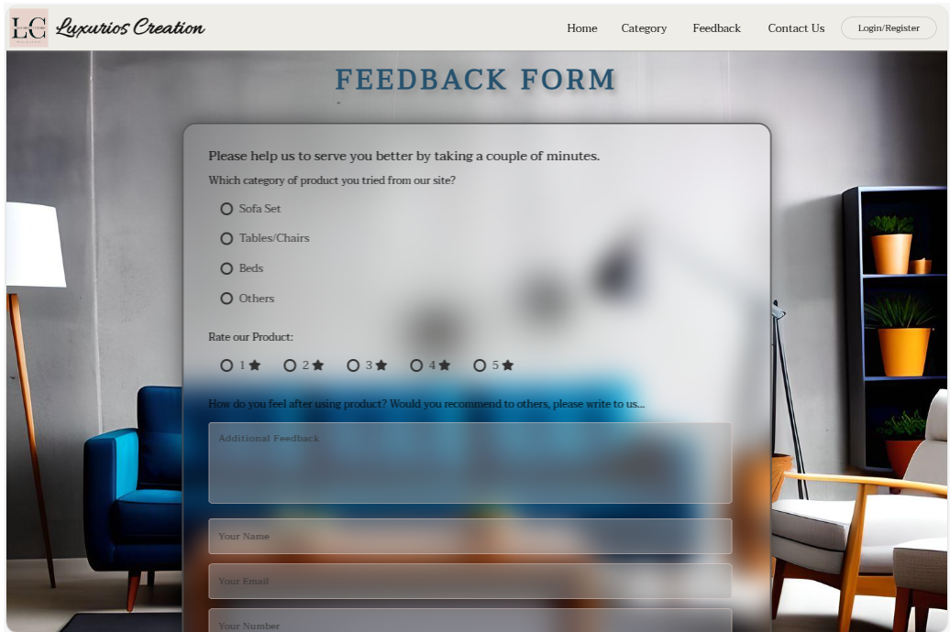
Result
Figure 5: Feedback Page

Slide 14
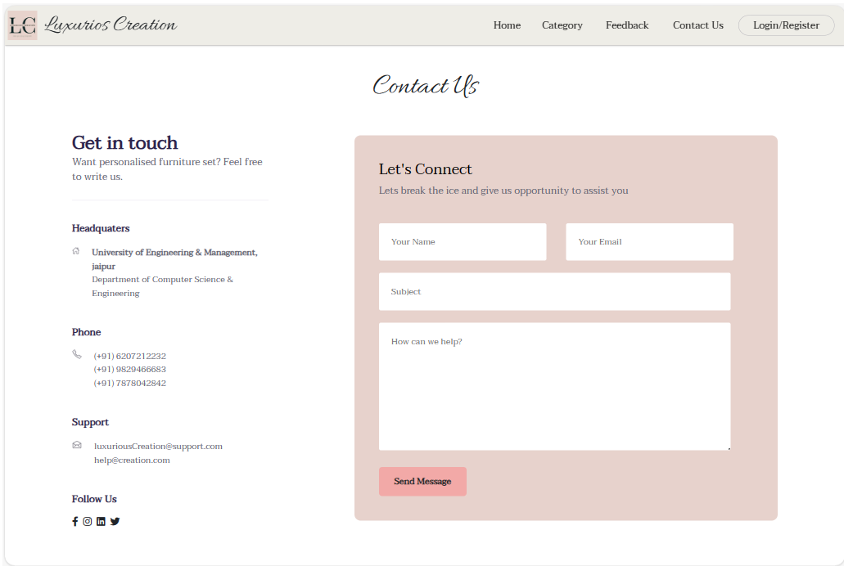
Result
Figure 6: Contact Us Page

Slide 15
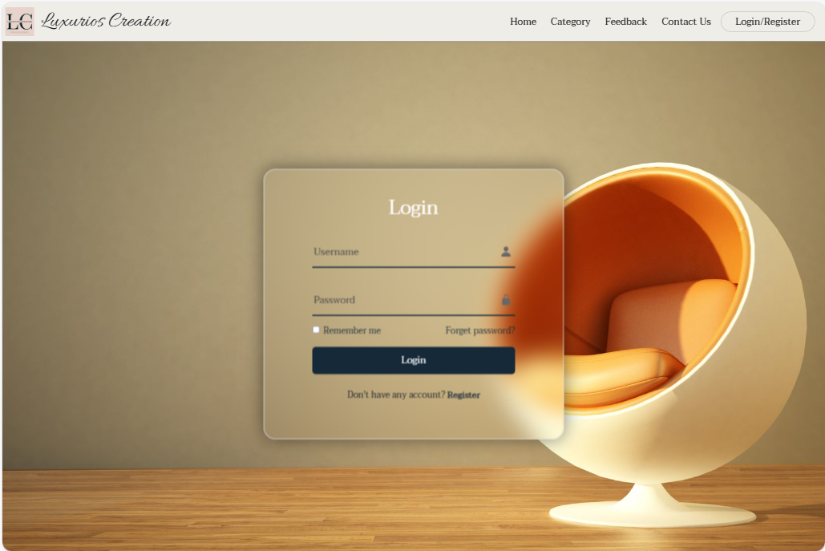
Result
Figure 7: Login/Registration Page

Slide 16
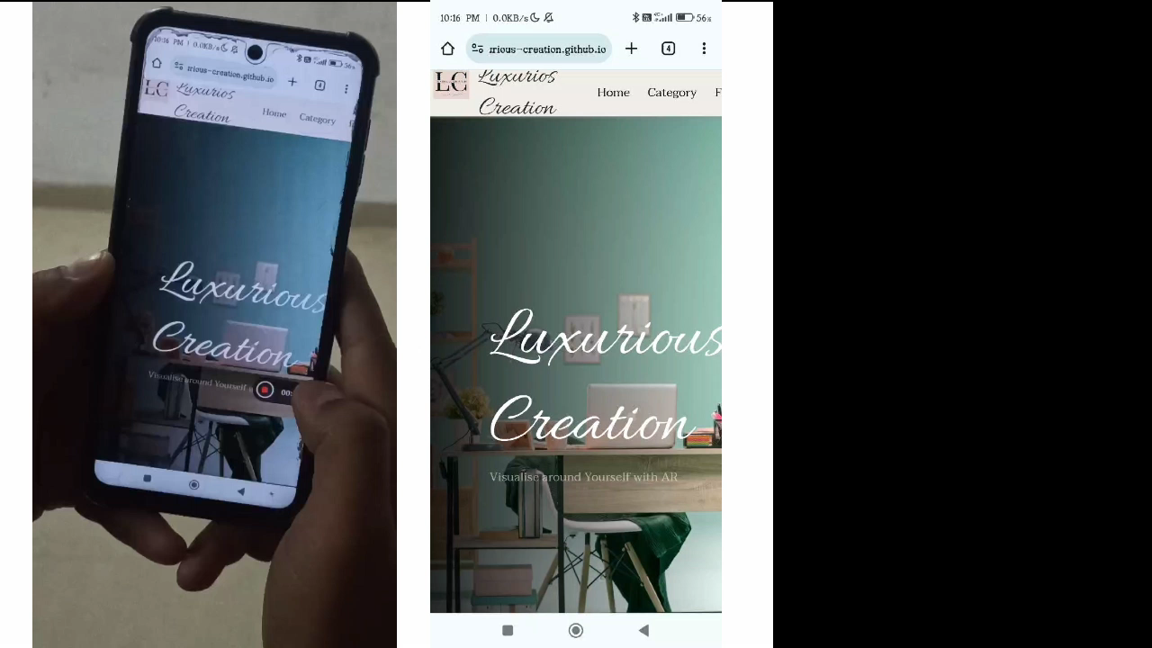
Result

Slide 17
Result Analysis
The website has successfully transformed the online furniture buying experience by prioritizing user satisfaction through a meticulously designed, user-friendly environment.
The challenges of colour selection have been effectively addressed, providing users with tools and features to make accurate choices. The inclusion of customization options allows for a personalized touch, enabling users to create furniture that aligns perfectly with their preferences.
Overall, these collective efforts have resulted in a comprehensive and immersive online furniture shopping experience that goes beyond traditional e-commerce, making the process not only convenient but also enjoyable for users.

Slide 18
Conclusions & Future Scope
Luxurious Creations, the AR-powered furniture website, combines cutting-edge technology with exquisite design, offering users a seamless virtual shopping experience with augmented reality.
Luxurious Creations, the furniture website using cool AR stuff, is set for an awesome future! We're thinking about adding more furniture styles and colours for you to pick from. Imagine customizing your furniture exactly how you want!

Slide 19
References
[1] Genevese, P., Lanadia, N., & Quint, V. (2012, April). on the analysis of Cascading Style_Sheets_Researchgate.https://www.researchgate.net/publication/254008906_On_the_Analysis _of_Cascading_Style_Sheets.
[2] Paula. (n.d.). Creating 3D content for augmented reality. (2020, May 3). wikitude.https://shorturl.at/oLQX0.
[3] Peroni, S., Osborne, F., Di Iorio, A., Nuzzolese, A. G., Poggi, F., Vitali, F., & Motta, E. (2017). Research articles in Simplified HTML: A web-first format for HTML-based scholarly articles. PeerJ Computer Science, 3. https://doi.org/10.7717/peerj-cs.132.
[4] Quintero, J., Baldiris, S., Rubira, R., Cerón, J., & Velez, G. (2019). Augmented reality in educational inclusion. A systematic review on the last decade. Frontiers in Psychology, 10. https://doi.org/10.3389/fpsyg.2019.01835.

Slide 20
References
[5] Saidin, N. F., Abd Halim, N. D., & Yahaya, N. (2015). A review of research on augmented reality in education: Advantages and applications. International Education Studies, 8(13). https://doi.org/10.5539/ies.v8n13p1.
[6] Silva, R. L. S., Oliveira, J. C. de, & Giraldi, G. A. (2003, January). Introduction to augmented.reality.https://www.researchgate.net/publication/277287908_Introduc-tion_to_augmented_reality.

Slide 21
Acknowledgement
We extend our heartfelt thanks to our research supervisor Prof. Jyoti Khandelwal, for their guidance and support.
Thanks to UEM, Jaipur for resources. Gratitude to the open-source community for the technologies used.

Slide 22

Dept. of CSE, University of Engineering & Management Jaipur

